Slide 1
TEAM
DEVELOPMENTALITY
PROJECT MANAGEMENT
JUNE 5, 2023

Slide 2
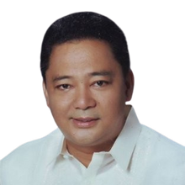
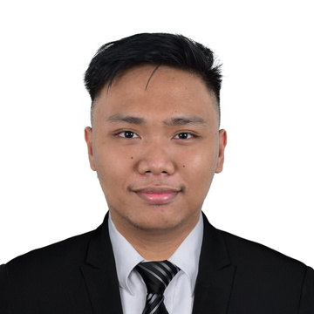
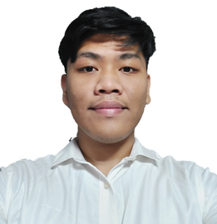

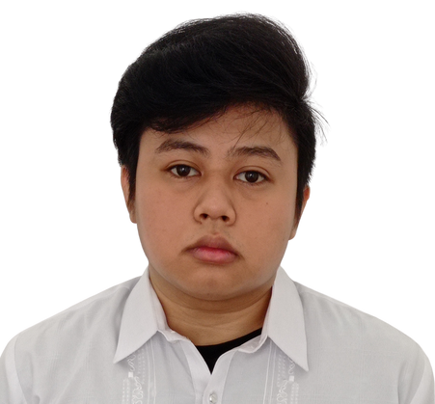
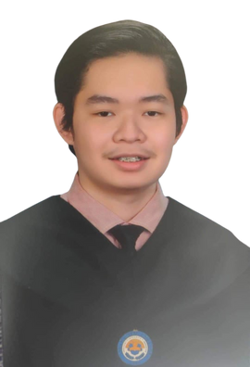
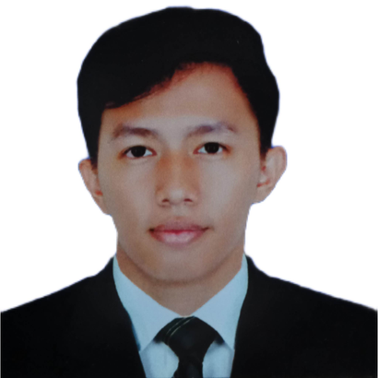
Project Advisor
Alvin C. Limpin
Scrum Master
Jakerson B. Bermudo
Product Owner
Wilkins V. Caducio
Documentation Manager
Princess Joy H. Ferrer
Project Manager
Mikedale B. Dellera
Scrum Member
Rark Mowen L. Alcantara
Scrum Member
Carl James A. Garcia

Slide 3
BARANGAY SOUTH SIGNAL VILLAGE
WEB-APP

Slide 4

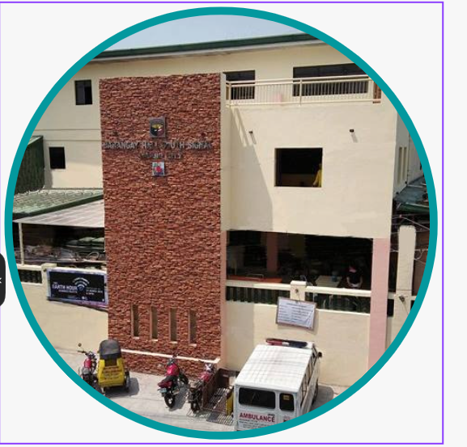
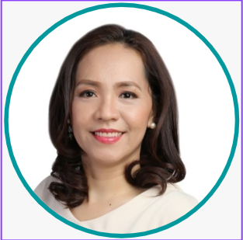
INTRODUCTION
Representative
Hon. Michelle Ann M. Odevilas
(Punong Barangay)
Client
Barangay South Signal Village
Presented by: Rark Mowen Alcantara

Slide 5
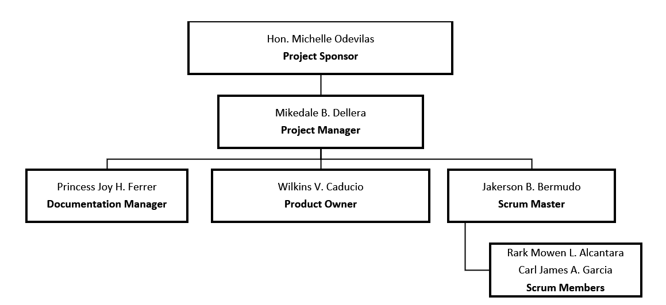
INTRODUCTION
Presented by: Mikedale Dellera

Slide 6




PROBLEM STATEMENT
Long Processing
Time
Risk of acquiring disease/s
Common errors using manual input
Manual search of records in the database
Unsecured Database
Presented by: Wilkins Caducio

Slide 7
PROBLEM PURPOSE / JUSTIFICATION
Barangay South Signal Village is facing challenges in providing efficient, transparent, and accessible services and information to its residents. The system involves manual processes, limited access to crucial data, and potential service delays.
Presented by: Princess Joy Ferrer

Slide 8
PROJECT DESCRIPTION
The proposed solution of the team to the client is to build a centralized and live web application for their barangay residents that have different functions:
(1) About Us
(2) Safety Section
(3) Contacts
(4) Requirements Guidelines
In the proposed project of the team, the resident can register in the web-application wherein they will have their own profile dashboard that will utilize the functions of the barangay’s web-app such as:
(1) Online Request
(2) Submitting Concern
(3) Track Request
(4)Transaction History
Presented by: Jakerson Bermudo

Slide 9
GOALS AND OBJECTIVES
Develop a web app to streamline document requests, reducing processing time by 80%.
2. Enable vulnerable residents to request documents online, minimizing contact and disease risk.
3. Implement online forms to eliminate errors caused by illegible handwriting and manual input
mistakes by 90%.
4. Provide real-time insights to barangay staff through a statistics dashboard.
5. Establish a secure, cloud-based data storage system, offering 90% more security than
traditional filing cabinets.
Presented by: Mikedale Dellera

Slide 10
PROJECT DELIVERABLES
Fully functional web-application and the source code.
2. Recommendation lists for hardware and software that will be used.
3. Project documentation for the web-application solution
User’s Manual
Business Case
Stakeholders Management Strategy Plan
Scope Management Plan
Cost Management Plan
Time Management Plan
Human Resource Management Plan
Communication Management Plan
Procurement Management Plan
Project Status Reports Distribution plan
Implementation Plan
Change Management Plan
Presented by: Jakerson Bermudo

Slide 11
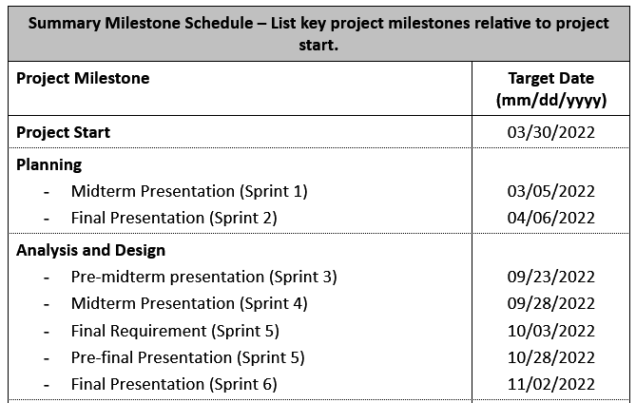
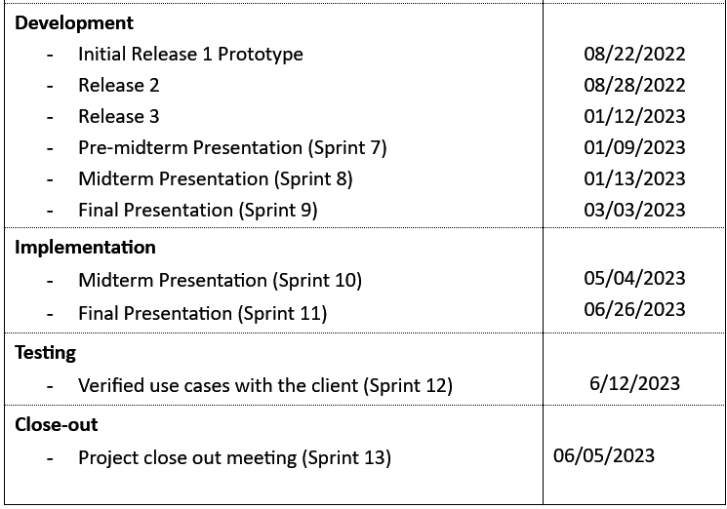
SUMMARY MILESTONES
Presented by: Princess Joy Ferrer

Slide 12
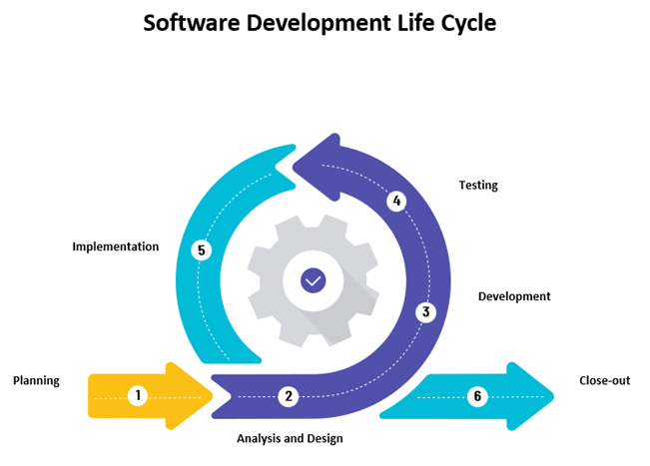
METHODOLOGY
Presented by: Wilkins Caducio

Slide 13
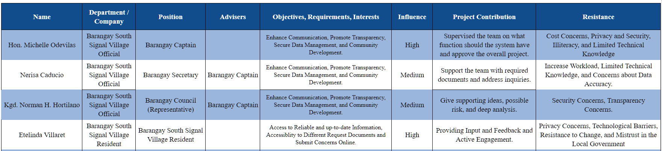
STAKEHOLDER ANALYSIS
Presented by: Princess Joy Ferrer

Slide 14
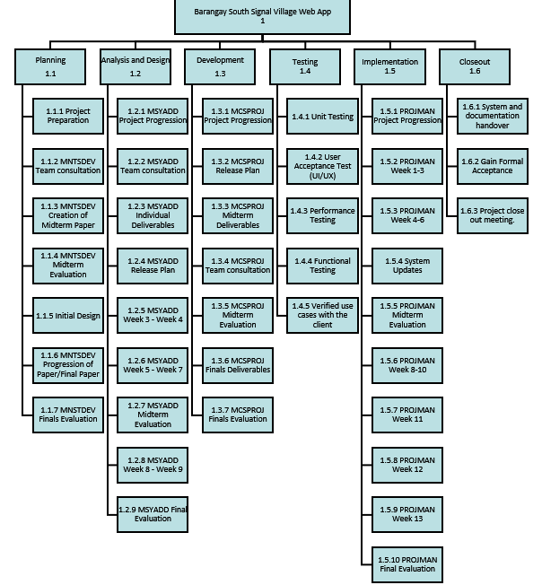
WBS
Presented by: Mikedale Dellera

Slide 15
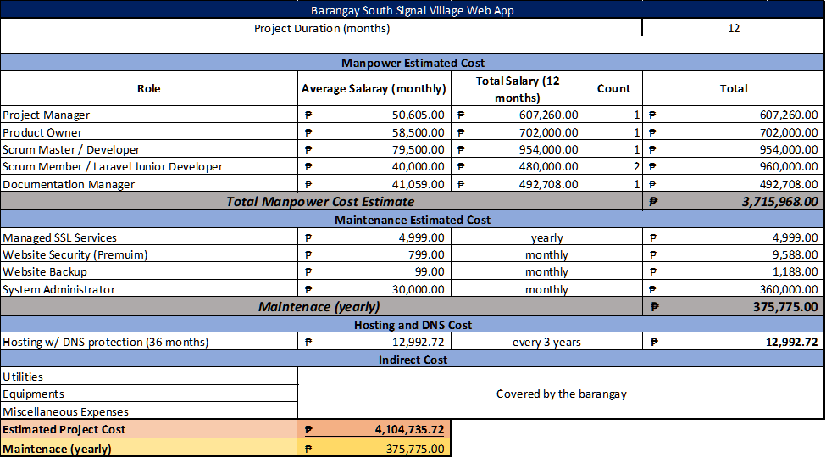
PROJECT COST
Presented by: Jakerson Bermudo

Slide 16
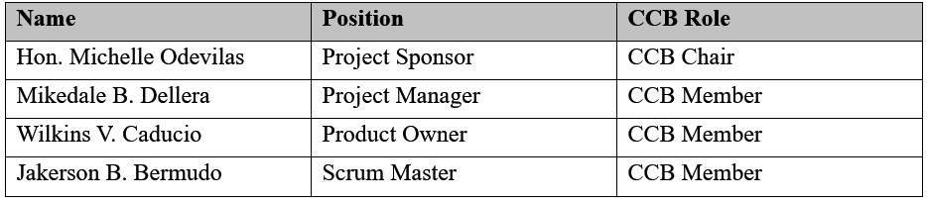
CHANGE CONTROL BOARD
Presented by: Wilkins Caducio

Slide 17
ROLES AND RESPONSIBILITIES
Project Sponsor:
• Approve all major changes to the web application
• Approve all changes to schedule baseline
• Approve any changes in project scope
• Chair the CCB
Project Manager:
• Receive and log all change requests from project team
• Conduct preliminary risk, schedule, and scope analysis of change prior to CCB
• Seek clarification from change requestors on any open issues or concerns
• Make documentation revisions/edits as necessary for all approved changes
• Participate on CCB
Project Team:
• Submit all change requests on standard organizational change request forms.
• Provide all applicable information and details on change request forms
• Be prepared to address questions regarding any submitted change requests
• Provide feedback as necessary on the impact of proposed changes
Presented by: Wilkins Caducio

Slide 18
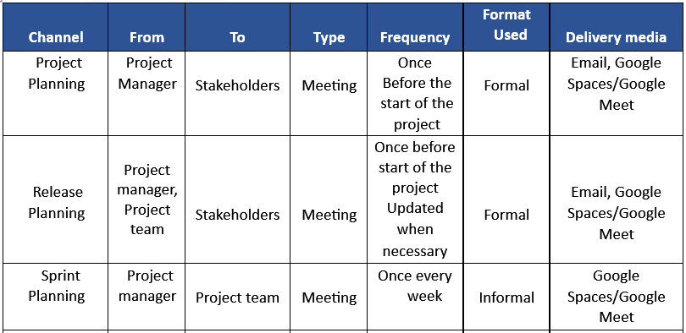
COMMUNICATION MATRIX
Presented by: Carl James Garcia

Slide 19
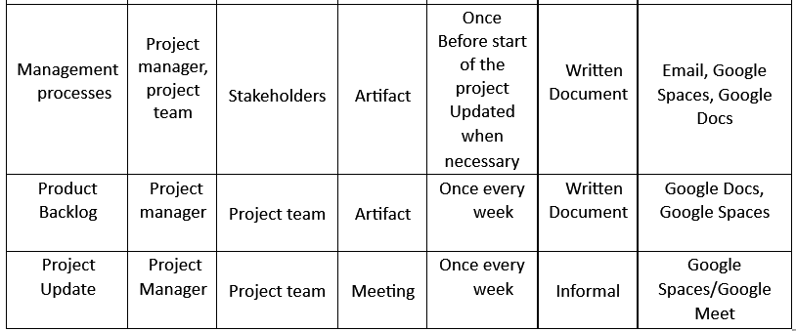
COMMUNICATION MATRIX
Presented by: Carl James Garcia

Slide 20
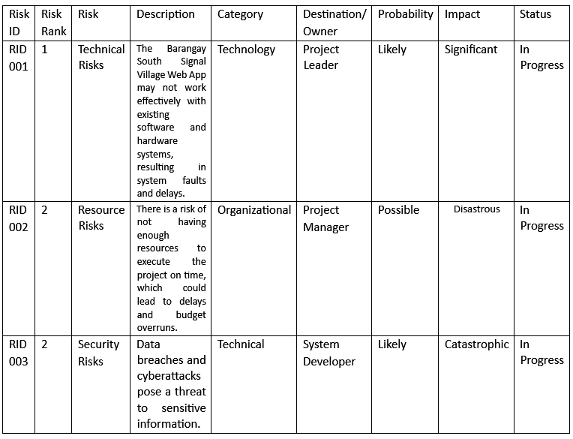
RISK REGISTER
Presented by: Rark Mowen Alcantara

Slide 21
TRANSITION APPROACH
Communication Plan: Prepare a detailed plan to keep stakeholders informed about transition plans, schedules, and
expectations through regular updates, meetings, and documentation.
2. Transition Planning: Collaborate with Barangay South Signal Village to create a comprehensive transition plan that
includes activities,
responsibilities, and timelines for data migration, system configuration, and verification.
3. Knowledge Transfer: Facilitate knowledge transfer through user guides, technical documentation, and training
sessions to equip the client's team with the necessary skills to support, maintain, and troubleshoot the system.
4. Resource Transfer: Carefully transfer project resources, including the web app's source code, database, licensing,
and other relevant assets, to the client to ensure a seamless handover and enable independent management and
operation.
Presented by: Carl James Garcia

Slide 22
HANDOVER PROCESS
Documentation Completion: Finalize and compile all necessary project documentation for future reference and
maintenance.
2. Training and Knowledge Transfer: Conduct training sessions to transfer knowledge and skills to stakeholders
responsible for operating and maintaining the web app.
3. System Testing and Quality Assurance: Conduct thorough testing to ensure the web app functions correctly and
meets quality standards. Address any identified issues or bugs.
4. Source Code and Deployment Assistance: Provide the client with the web app's source code and offer assistance in
deploying the app for seamless implementation.
5. Transition Planning: Develop a detailed transition plan outlining activities, responsibilities, and timelines for the
handover process, including key contacts and escalation procedures.
Presented by: Rark Mowen Alcantara

Slide 23
PROTOTYPE

